Slide 1



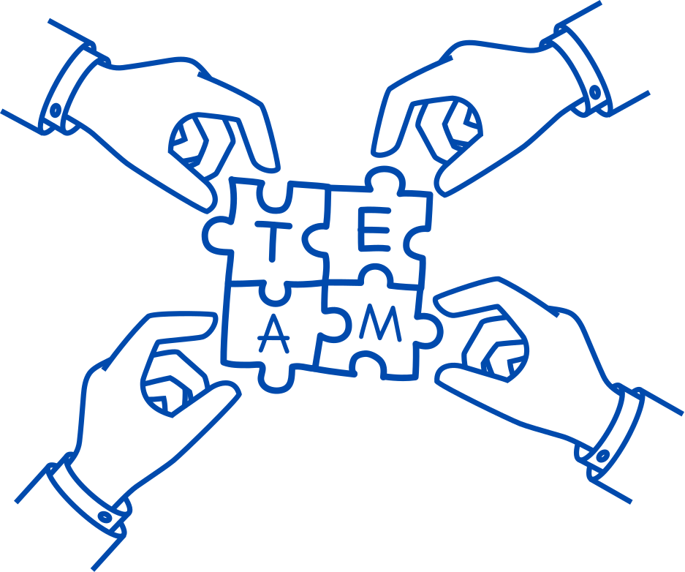

AI
The chatbot for all your healthcare needs!
HealthBot
Akanksha Khaire
Ayushi Porwal
Gabriela Gonzalez
Mansi Dhoke
Ivan Pantaleon

Slide 2

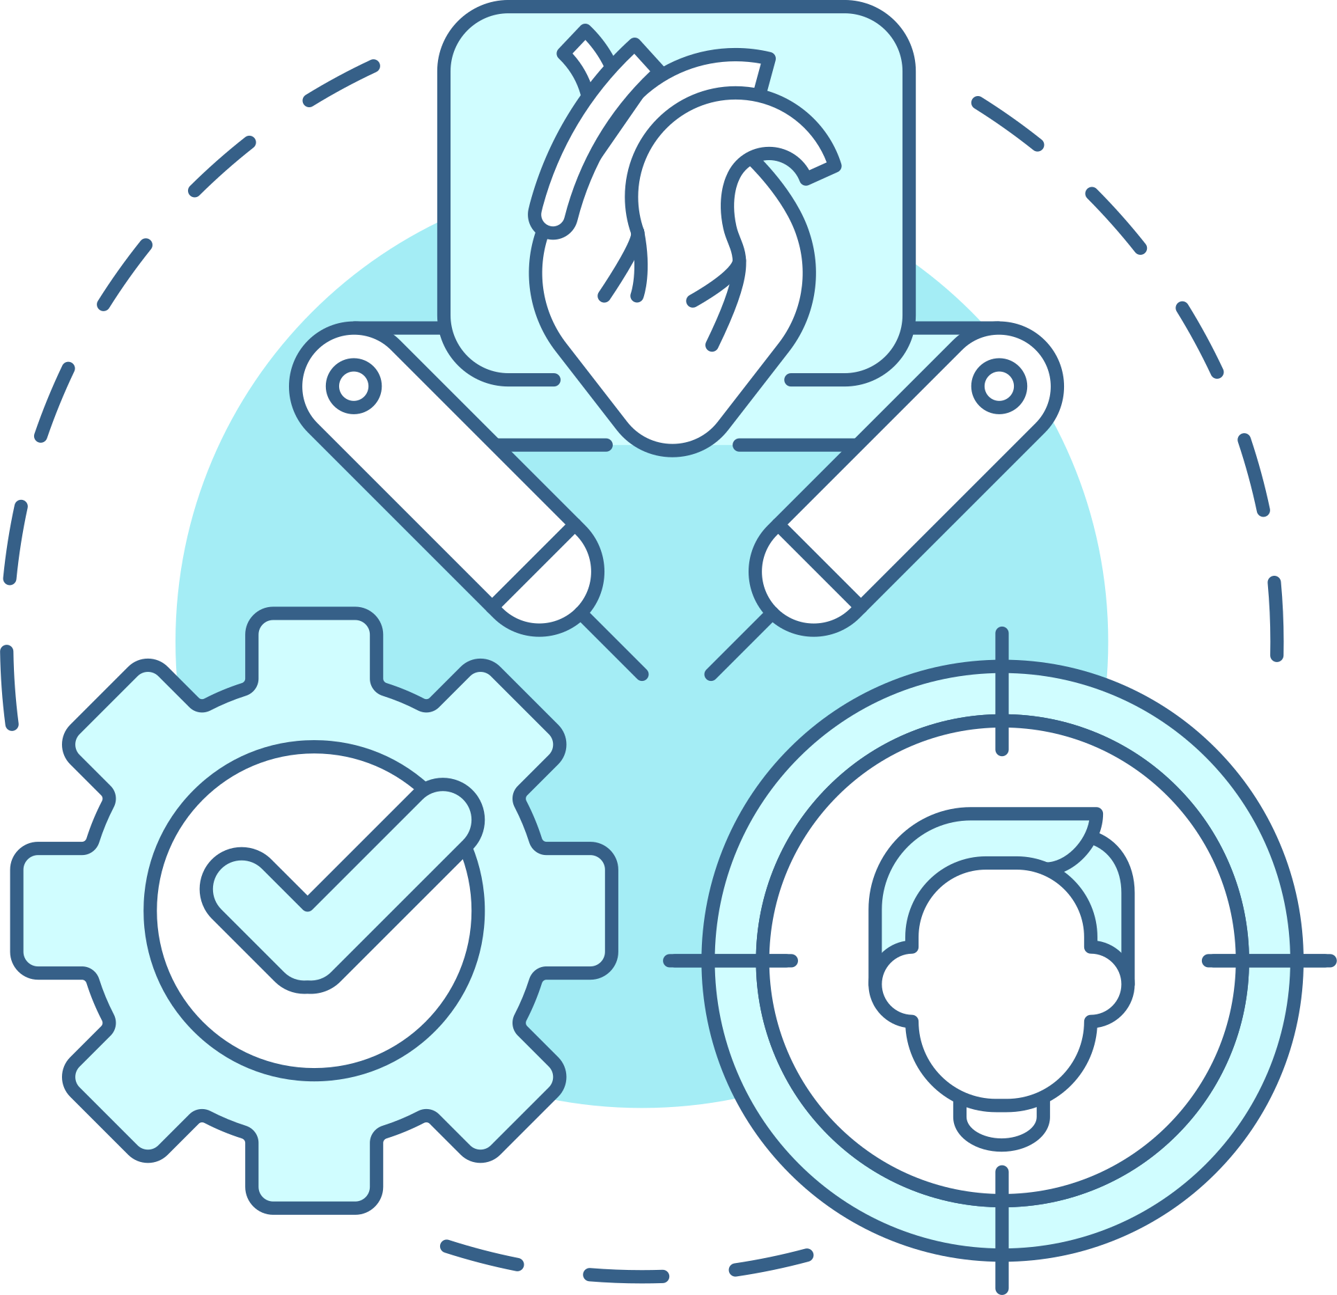

Introduction to Healthbot
Welcome to the Introduction to Healthbot.
The Healthbot project is designed to revolutionize healthcare interactions through advanced conversational AI technology.
Our primary goal is to enhance user experience, streamline healthcare information access, and provide personalized assistance.

Slide 3



Project Overview
Objective
Goals
Key Features
Transforming healthcare communication through innovative AI technology.
Enhance accessibility to health information.
Provide personalized assistance for health-related queries.
Streamline interactions between users and healthcare services.
Seamless integration with SAP for robust data management.
Intelligent conversations with HealthBot, with advanced natural language understanding and generation.
User-friendly interface for easy navigation and engagement.

Slide 4
Actions Taken
1
2
3
4
5
6
Create Project
Understand Intents and Entities
Define Health Intents
Add Expressions
Train Your Chatbot
Create Skills
7
8
9
10
11
12
Test Your Chatbot
Implement Dialog Flow
Monitor and Optimize
Implement Advanced Features
Test Again
Deploy Your Healthbot

Slide 5
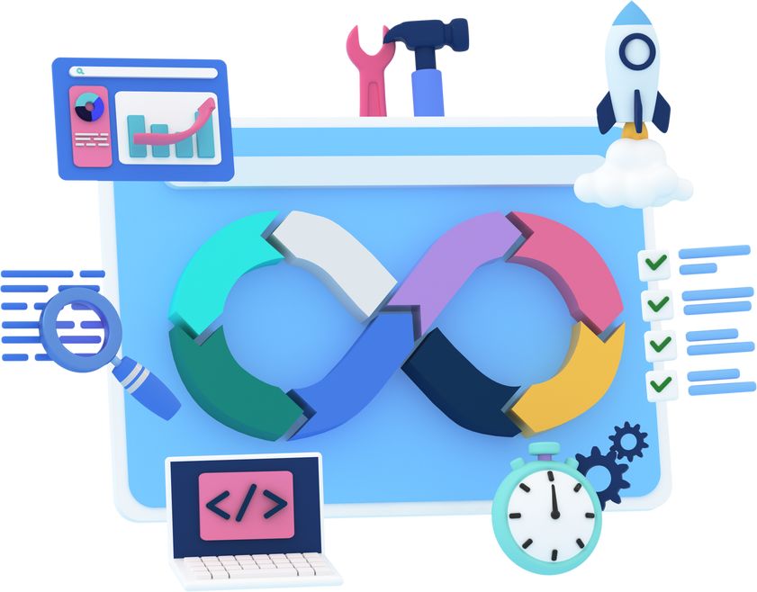
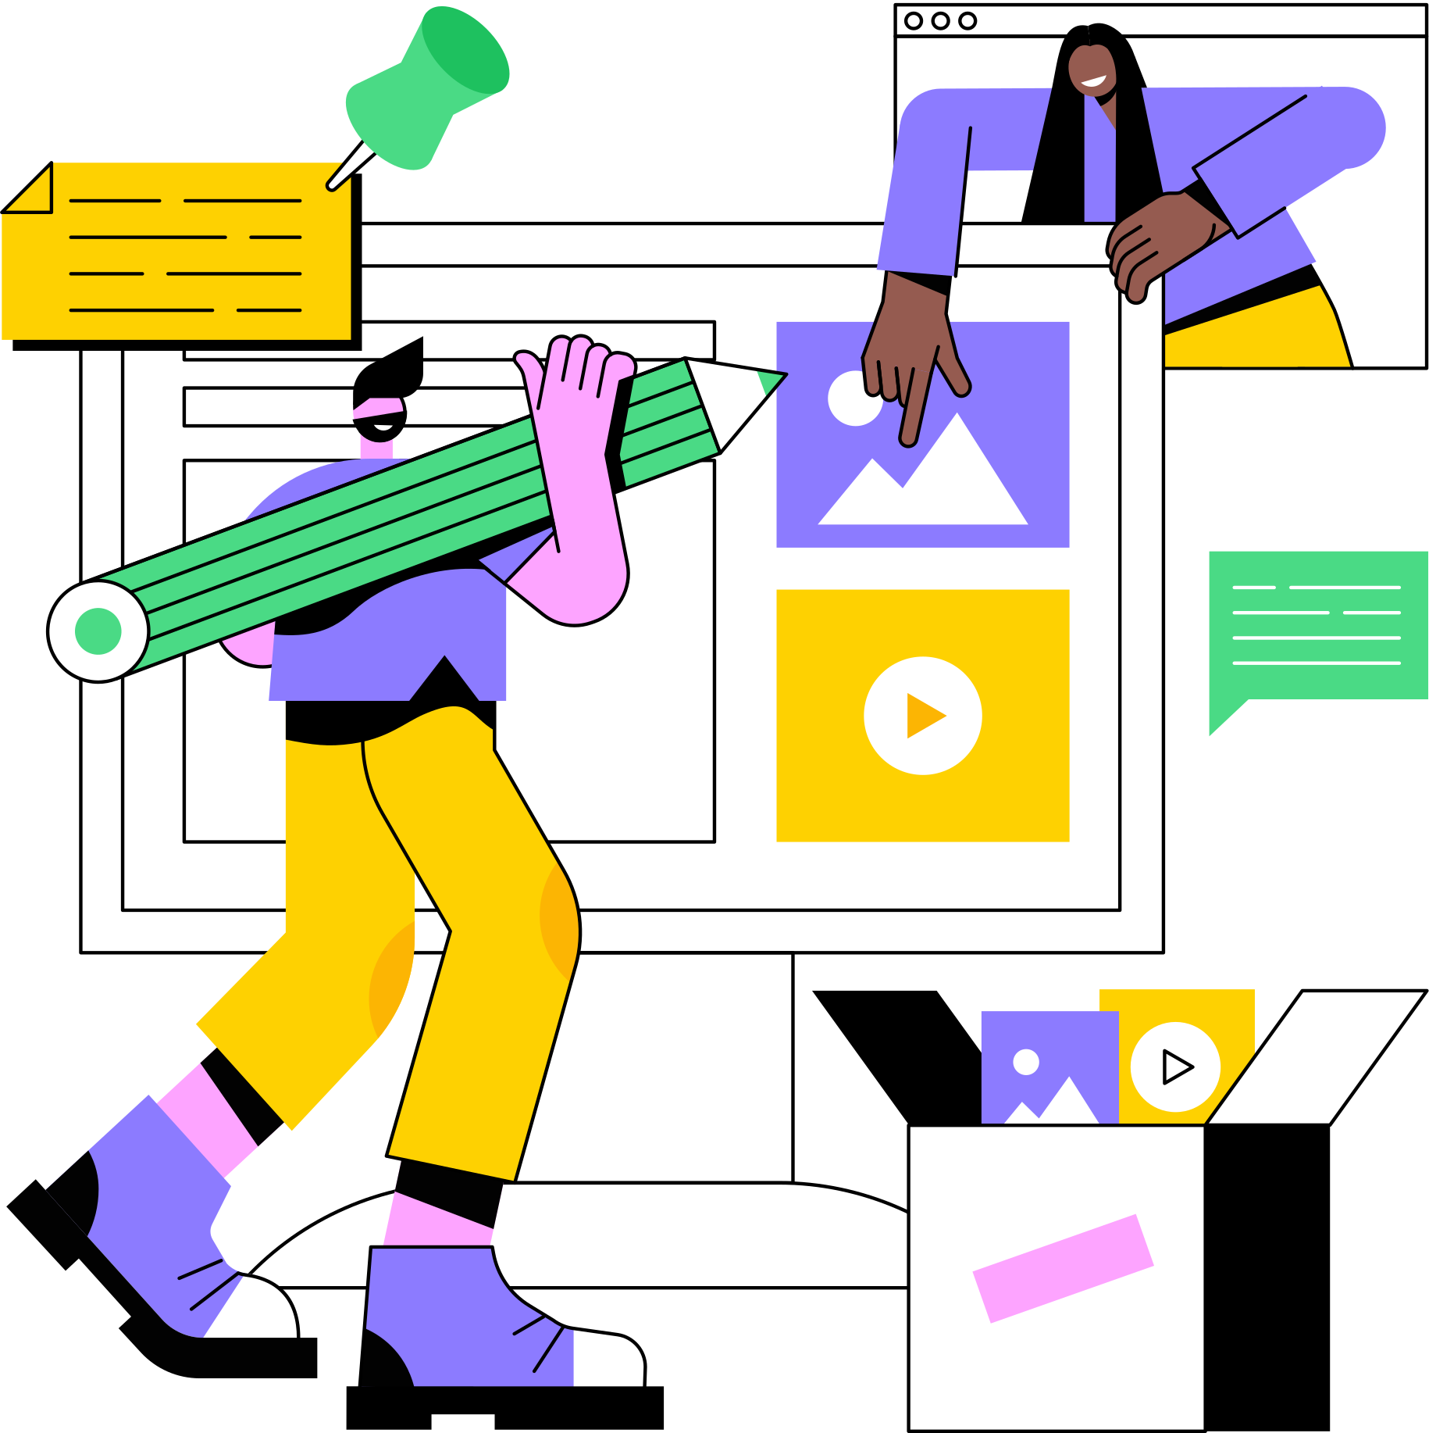
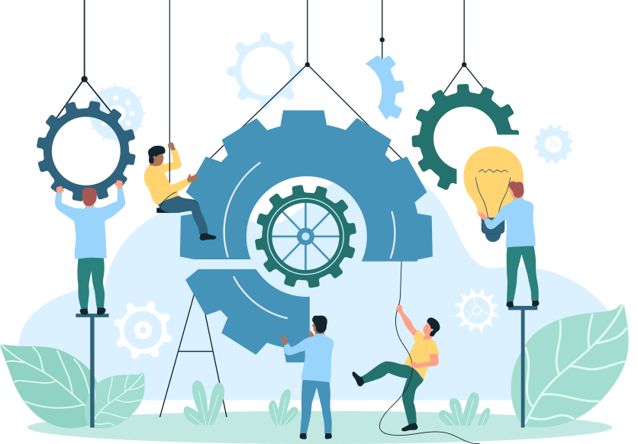
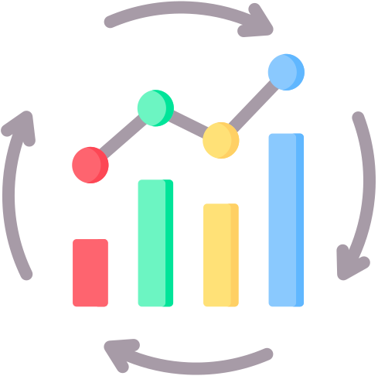
Integration with SAP
Integration Process:
Successfully created a dedicated website for the healthbot.
Seamlessly integrated the healthbot with SAP systems to enhance data accessibility.
Website Creation:
Developed a user-friendly website as a platform for the healthbot.
Designed an intuitive interface for easy navigation and engagement.
Key Integration Steps:
Website Development: Created a custom website tailored to the healthbot's functionalities.
Ensured the website serves as an efficient and accessible interface for users.
SAP Integration: Established a robust connection between the healthbot website and SAP systems.
Implemented API integration for real-time data exchange.
User Access: Enabled users to interact with the healthbot seamlessly through the integrated website.
Provided secure access to SAP data through the website interface.
Continuous Improvement:
Plan for ongoing enhancements to the website and SAP integration.
Explore opportunities to optimize data flow and user experience.

Slide 6

AI
DEMONSTRATION

Slide 7
Expressions and Actions
User Expressions
Sample Expressions
Implemented expressions to handle a variety of user queries and commands.
Included natural language understanding to enhance user-bot interactions.
"What are the symptoms of flu?"
"Schedule an appointment with Dr. Smith."
"Provide dietary advice for diabetes."
Actions
Sample Actions
Configured actions to execute specific tasks based on user requests.
integrated logical workflows to provide accurate and helpful responses.
get_flu_symptoms: Fetches information on flu symptoms.
schedule_appointment: Initiates the appointment scheduling process.
get_dietary_advice: Provides dietary recommendations for diabetes.

Slide 8
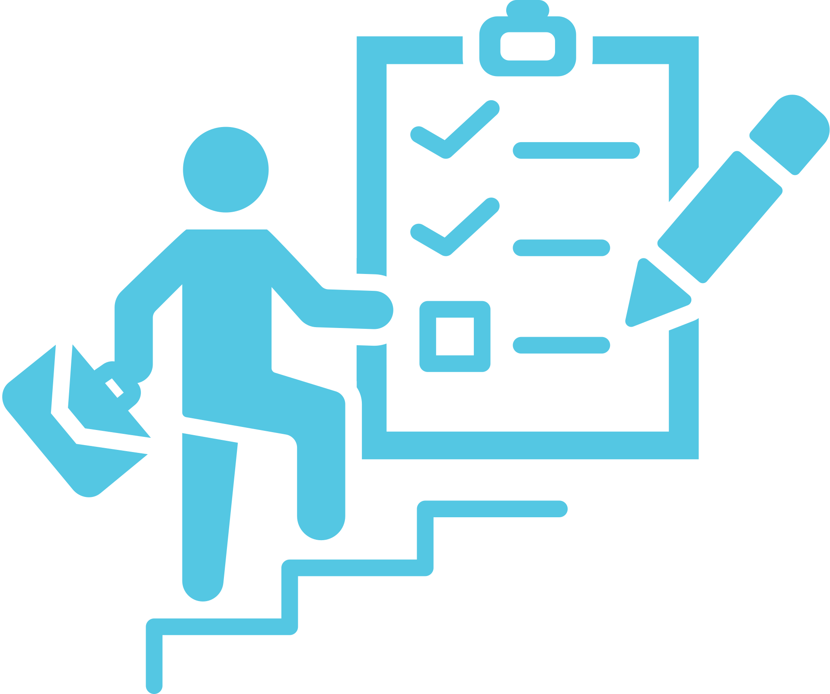
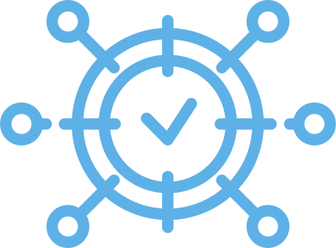



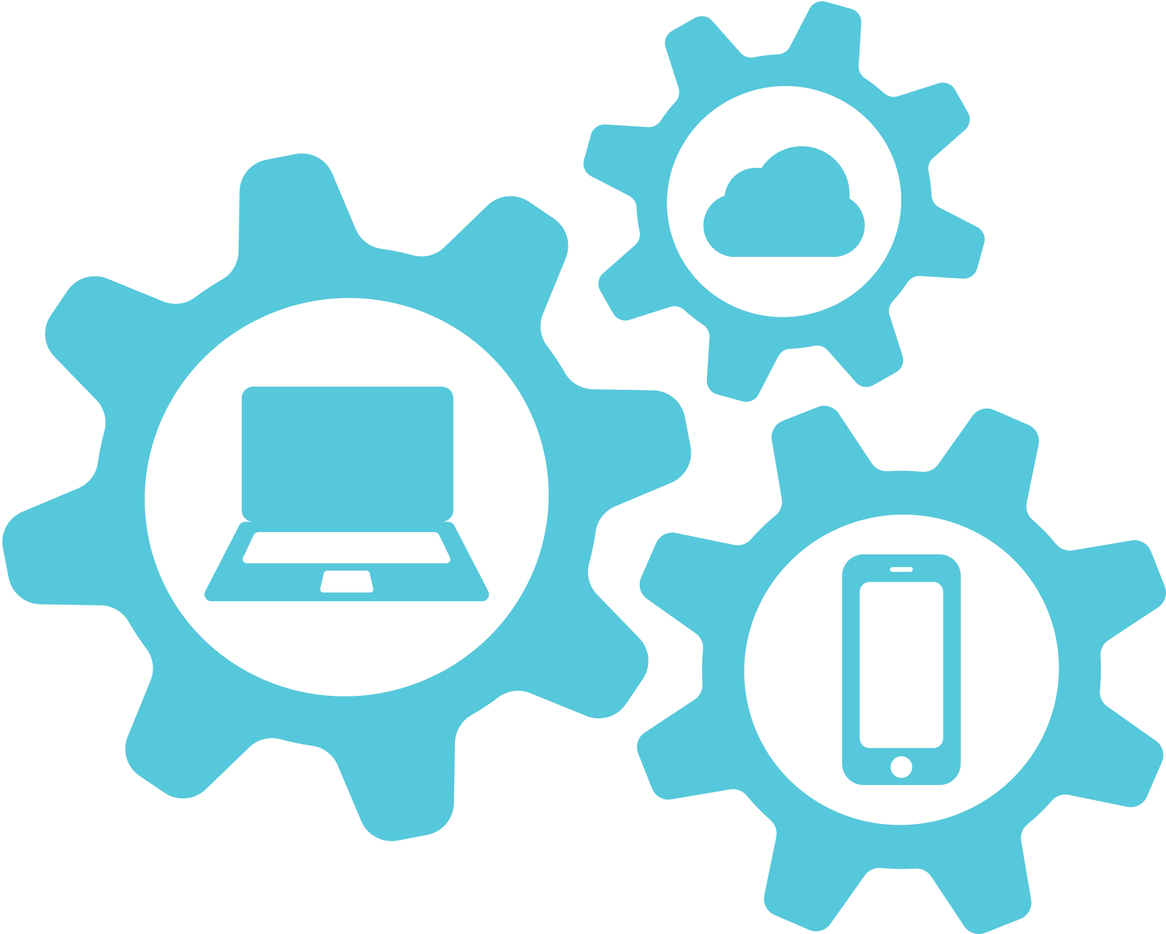



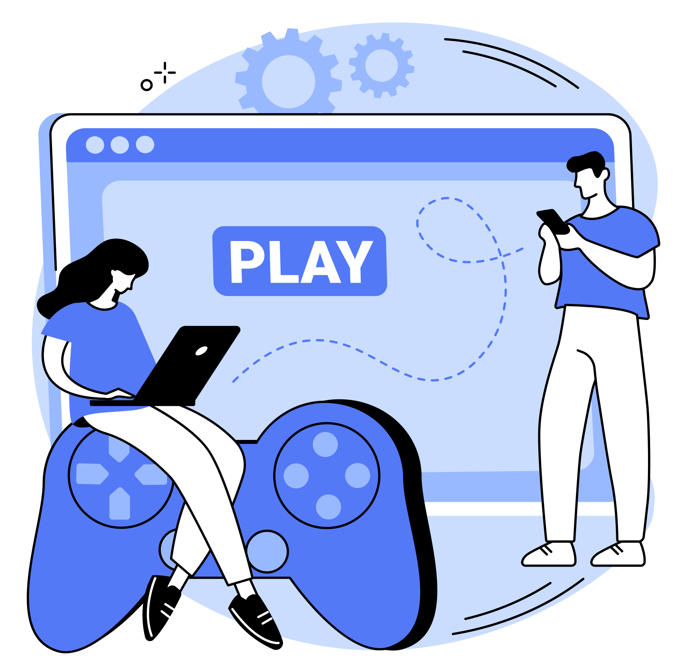
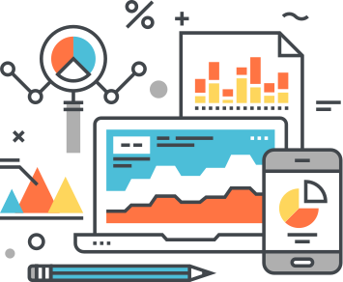
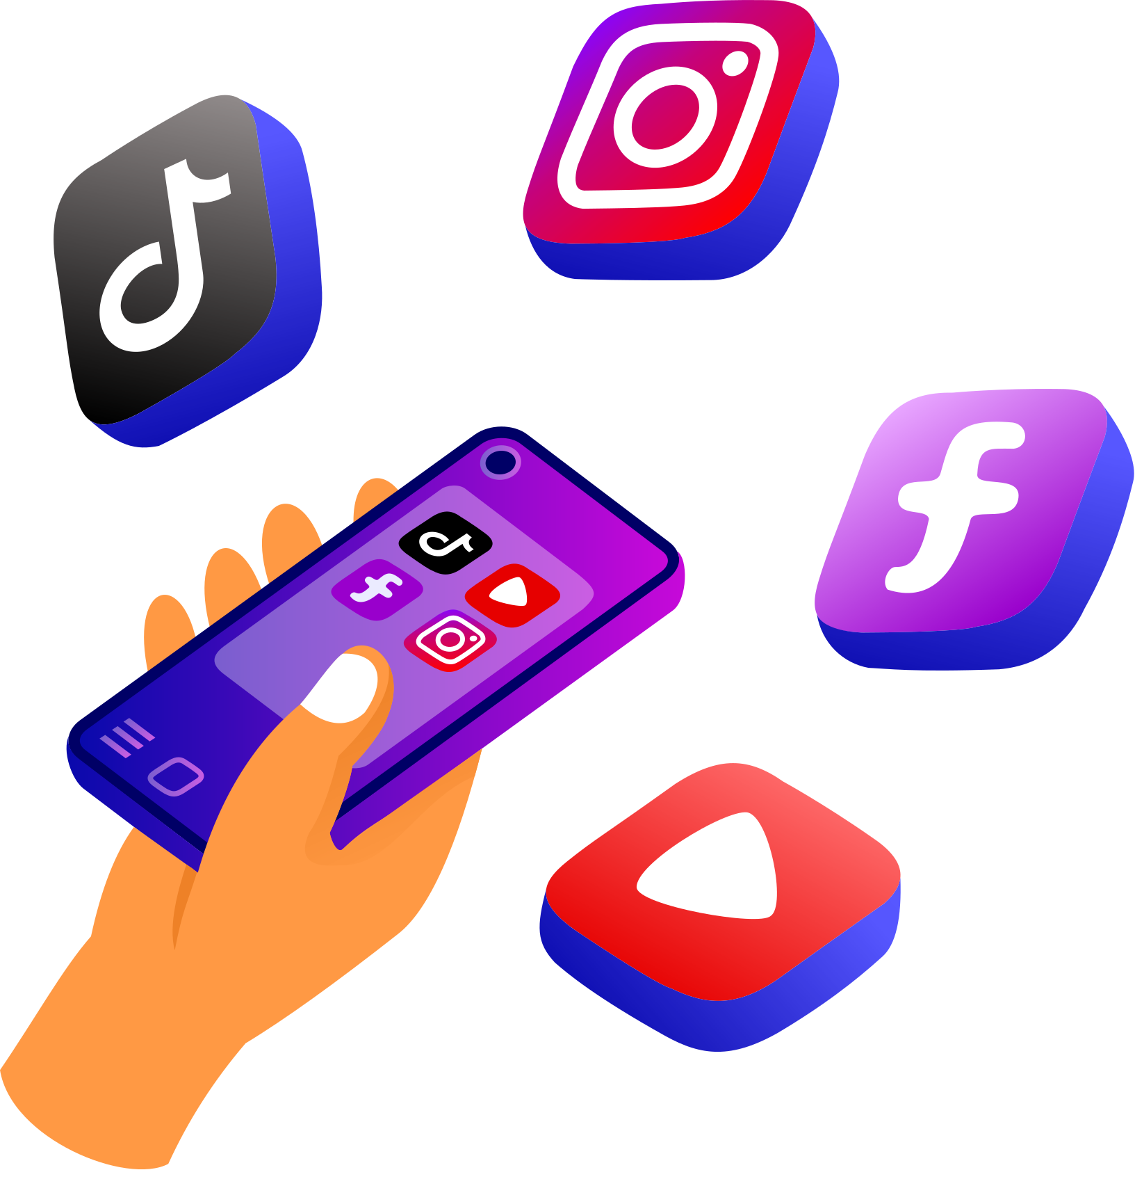
Future Enhancements
Advanced Integration
Personalization Features
Enhanced Security Measures
Voice and Multi-Modal Interaction
Integration with Wearable Devices
Telemedicine Integration
Emotional Intelligence
Continuous Learning and Training
Expanded Language Support
Cross-Platform Accessibility
Real-Time Analytics and Reporting
Social Media Integration

Slide 9


BUSINESS USE CASE
Personalized Wellness Plans
Engagement and Retention
Health Product Recommendations
Customer Support
Patient Engagement
Wellness and Fitness Companies
Retail and Consumer Services
Risk Assessment
Healthcare Industry
Insurance Providers
Operational Efficiency
Claims Assistance
SCENARIO
Medication Guidance
Wellness Incentive Programs
Pharmaceutical Sector
Financial Institutions
Corporate Healthcare Programs
Product Information
Risk Mitigation
Employee Wellness
Health Education

Slide 10
CONCLUSION
The Healthbot project, driven by advanced conversational AI, is poised to revolutionize healthcare interactions.
Successfully achieved project goals, enhancing accessibility, and providing personalized assistance in healthcare interactions.
Users now experience streamlined access to health information with personalized support, contributing to an improved healthcare experience.
Committed to continuous refinement, acknowledging the iterative nature of enhancing the Healthbot based on user feedback.
Encouraging ongoing development and user engagement, ensuring the Healthbot evolves with emerging needs and technological advancements.
As we conclude this introduction, envision a future where healthcare is seamlessly intertwined with cutting-edge AI. What possibilities lie ahead for redefining the landscape of healthcare interactions?
5

Slide 11
